Slide 1
Weather

Slide 2
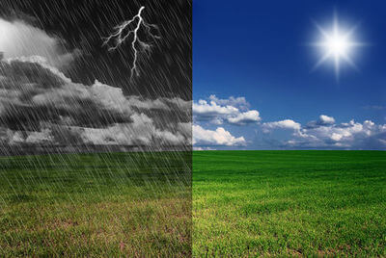
Weather is the state of the local atmosphere over short time periods. This is different to climate, which is the average atmospheric conditions over a large area for a long time period.

Slide 3
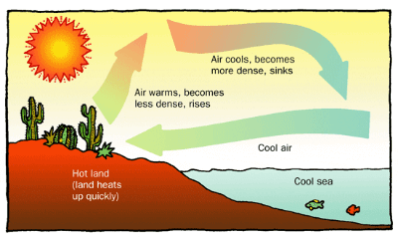
Convection currents determine the weather near the ocean. Hot air over land rises during the day and moves out to sea, causing an onshore wind to bring cool air from over the ocean into land.
At night the cold air over land moves out to sea, causing an offshore wind.
Water has the highest known specific heat capacity of any substance. Therefore, it does not change temperature as quickly as everything on land does. This means that land has a faster change in temperature than the oceans.

Slide 4
Energy in the environment undergoes adiabatic heating and cooling. This means that energy is only transferred by work, so no energy enters or leaves the system.
Gases change their pressure, temperature, and volume during adiabatic processes.

Slide 5
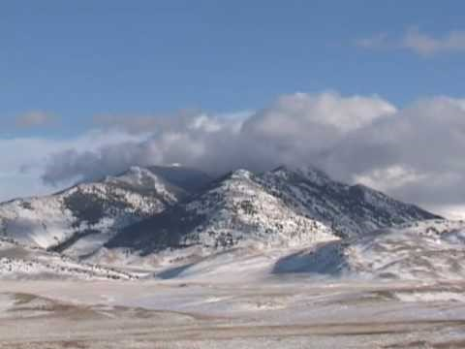

Slide 6
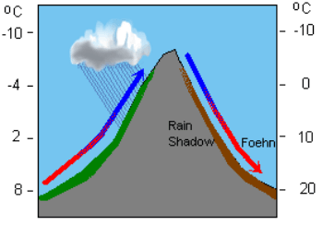
As you saw in the video, atmospheric adiabatic heating and cooling occurs when air is forced up the side of a mountain.
The air expands, causing the temperature to drop. This causes water vapour to condense, forming clouds and falling as rain.
On the other side of the mountain, the air sinks and compresses. This causes the temperature to rise, causing the cloud to dissipate.

